Slide 1
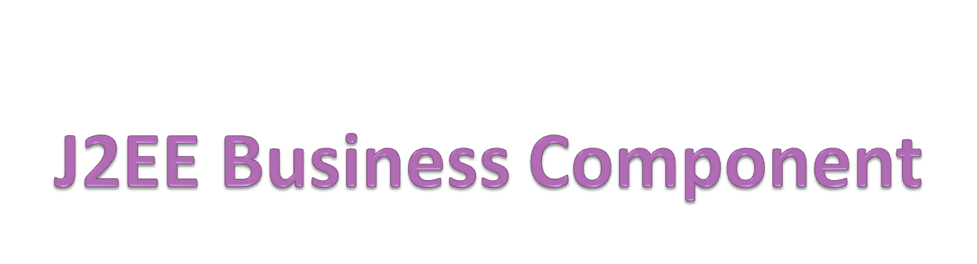
ISDV 547

Slide 2
J2EE Architecture
Defines the standard for developing multi-tier enterprise applications
Provide a complete platform to write portable, secured, multi-user server side applications in Java
These applications are named “enterprise applications”.

Slide 3
J2EE Architecture (Cont.)
The features that make enterprise applications powerful, like security and reliability, often make these applications complex
The Java EE platform is designed to reduce the complexity of enterprise application development by providing a development model, API, and runtime environment that allows developers to concentrate on functionality.

Slide 4
Tiered Applications
In a multi-tiered application, the functionality of the application is separated into isolated functional areas, called tiers
Typically, multi-tiered applications have a client tier, a middle tier, and a data tier
  The client tier consists of a client program that makes requests to the middle tier.
  The middle tier's business functions handle client requests and process application data, storing it in a permanent datastore in the data tier and ...

Slide 5
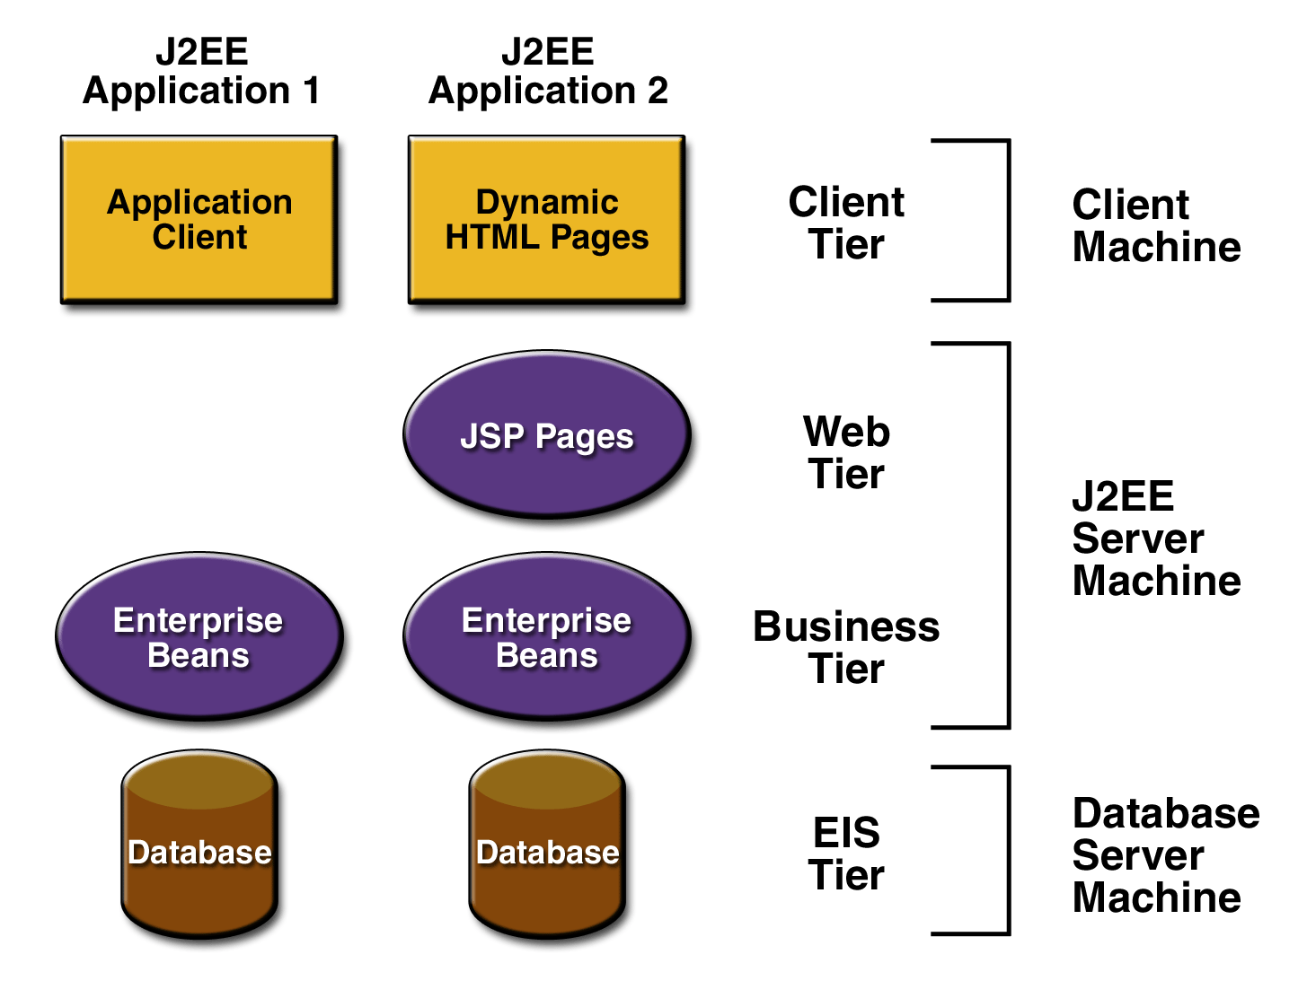

Source: http://java.sun.com/.../tutorial/doc/Overview4.html

Slide 6
The Business Tier
The middle tier sometimes are called the Business tier.
The business tier consists of components that provide the business logic for an application
The following Java EE technologies are used in the business tier in Java EE applications:
  Enterprise JavaBeans (enterprise bean) components
  JAX-WS web service endpoints
  Java Persistence API entities

Slide 7
Java EE Servers
A Java EE server is a server application that the implements the Java EE platform APIs and provides the standard Java EE services
Java EE servers also called Application Servers
Java EE servers contain several application component types corresponding to the tiers in a multi-tiered application.
These components are called container:
    Containers manage the life cycle of the components, provide access to resources such as database , directory service.

Slide 8
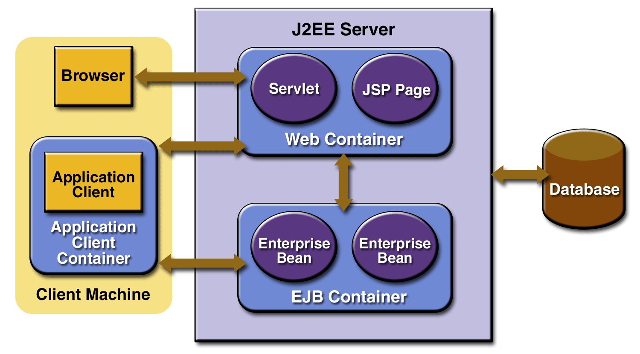
Source: http://java.sun.com/.../tutorial/doc/Overview4.html

Slide 9
Java EE Servers (Cont.)
The Web Container
  Manages the execution of JSP page and servlet components for J2EE applications.
  Web components run on the J2EE server.
The Application Client Container
  Manages the execution of application client components
  Application clients and their container run on the client

Slide 10
Java EE Servers (Cont.)
The EJB Container
  Manages the execution of enterprise beans for J2EE applications.
  Enterprise beans and their container run on the J2EE server.

Slide 11
J2EE Application Architecture
Web-centric Architecture
EJB Component-centric Architecture
Business-to-Business Application Architecture
Web Service Application Architecture

Slide 12
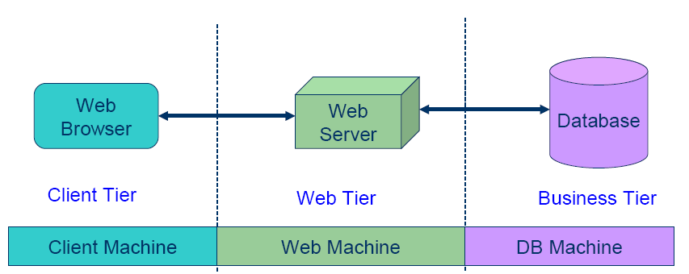

Web-centric Architecture
Application
JSP
Servlet

Slide 13
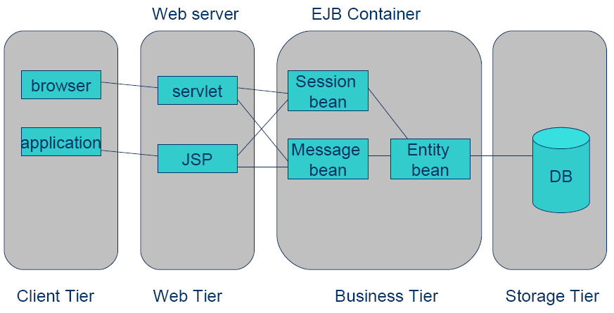
EJB Component-centric Architecture

Slide 14








Business-to-Business Application Architecture
Web Container
EJB Container
J2EE Server
Web Container
EJB Container
EIS Resources
J2EE Server

Slide 15



Web Service Application Architecture
Web Service Registry
Service Registry e.g.UDDI
WSDL Files
Discovery
Publish
J2EE Application Server
Bind
Service Endpoint Interface
Stateless Session Bean
Web Service Client
Web Service Requester

Slide 16
J2EE Application Servers
Some of the better-known Java Enterprise Edition application servers are:
BEA Weblogic
IBM WebSphere
JBOSS Application Server (Red Hat)
Apache Tomcat Application Server
Oracle Application Server
GlassFish Application Server

Slide 17
Enterprise Java Beans (EJB)
Enterprise Java Beans are:
  Server-side components which can be loaded by an EJB container
  Perform business logic on the server
  Handle sessions
  Act as interface to a database
It is a specification not a product.

Slide 18
Not to Do in Writing an EJB Component
Write Remote access protocol
Threads
Security
Object life cycle
Resource pooling
State management

Slide 19
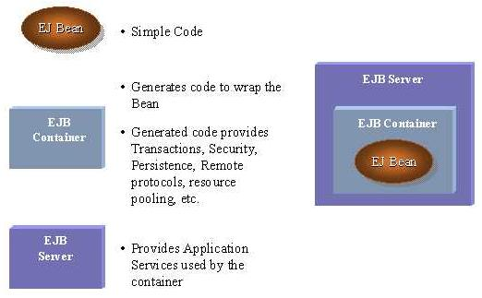
EJB Overview
Source: http://www.softsmith.com/webinars/java_ejb_presentation.ppt

Slide 20
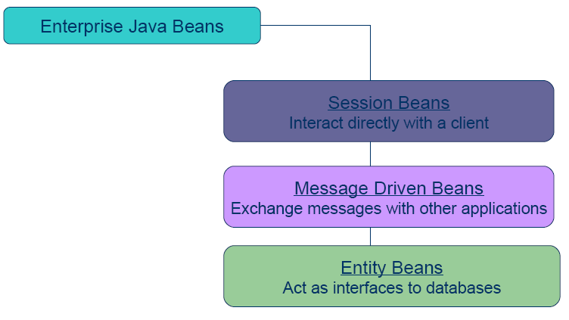
EJB Types

Slide 21
Session Beans
These beans model business processes
They can call other beans to assist in the calulations
Examples:
  A credit card authorization bean
Two types:
  Stateful session bean
  Stateless session bean

Slide 22
Message Driven Beans
Message Driven Beans are similar to session beans except that you communicate with them by sending
  Messages rather than method calls
  Messages are guaranteed to be delivered, even if the receiver is not available
  Messages are queued until the receiver is available and are then delivered

Slide 23
Entity Beans
Entity beans
  Model business data
  They have get and set methods just like a regular Java bean
  They act as interfaces to relational databases
  They automatically retrieve information from databases and store information in databases
  They cache instances in memory, which correspond to rows in the database

Slide 24
Entity Bean
Two types:
  With container-managed persistence
  With bean-managed persistence

Slide 25
EJB 2.0
An EJB
  Was derived from a special base class
  Had up to 5 other interfaces which had to be created
  Required the use of deployment descriptors for every EJB
  Was very laborious to create

Slide 26
EJB 3.0
An EJB is a Plain Old Java Object (POJO)
  This means it is just a regular class
Annotations are added to indicate the type of the bean and other information
The bean can implement a
  A remote interface
  A local interface
The use of annotations has dramatically reduced the amount of work to create an EJB

Slide 27
Why do you use EJB in your design?
Reusability
Encapsulate complexity of Business logic tier
Provides enterprise-level service
Secure Data hiding
Scalability
Multi-user server-side
Change Business Rules easily

